Slide 1
Resume Skill Matcher & Learning Recommendations

Slide 2
Introduction
Finding the right job requires matching a resume skills with job requirements.
Many applicants struggle with identifying gaps in their skills.
Our solution: An AI-based Resume Matcher to assess resumes, compare skills, and suggest learning resources.

Slide 3
Problem Statement
Challenges for Job Seekers:
Understanding whether their skills match a job role.
Identifying missing skills.
Finding the right learning resources.
Our Solution:
Extract skills from resumes.
Match them with job role requirements.
Provide a match score and learning recommendations.

Slide 4
Technologies Used
Programming Language: Python – Used as the core language for implementing NLP, ML, and UI functionalities.
Libraries:
NLP (Spacy, NLTK, Transformers): Extracts skills, named entities, and summaries from resumes.
Machine Learning (scikit-learn, Sentence Transformers): Computes similarity scores between resume skills and job role requirements using embeddings and TF-IDF.
File Handling (pdfplumber, docx2txt): Extracts text from PDF and DOCX resumes for processing.
Web Interface (Gradio): Creates an interactive UI for users to upload resumes and get skill match results.
API Used:
Ollama API for LLaMA 3.2 – Generates resume summaries using a powerful LLM, improving extraction quality

Slide 5
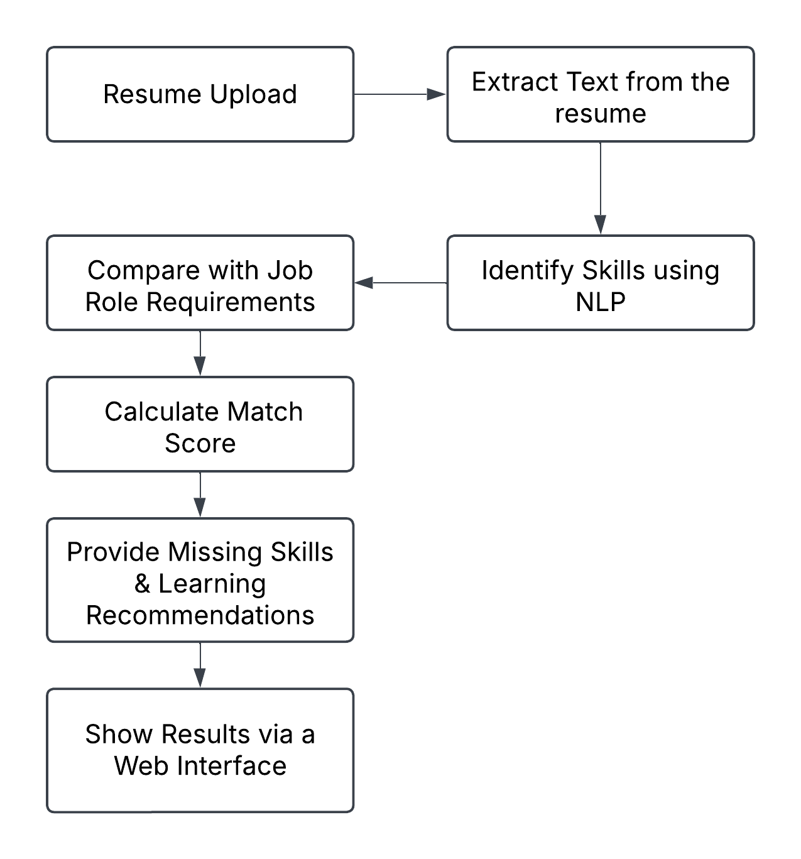
How It Works? (Pipeline Overview)

Slide 6
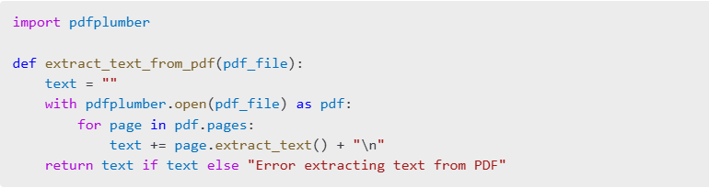
Extracting Text from Resumes
Resumes are in different formats like PDF, Word.
We use pdfplumber and docx2txt to extract text from PDFs and DOCX files.

Slide 7
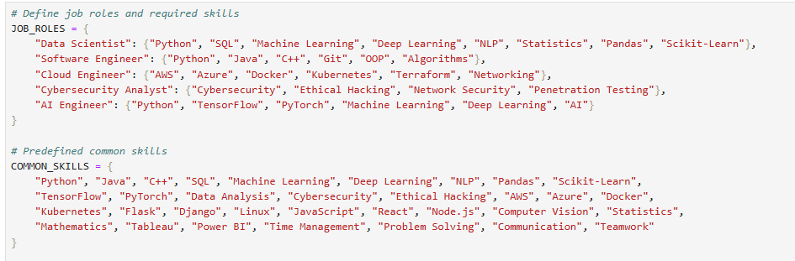
Job roles and Predefined common skills

Slide 8
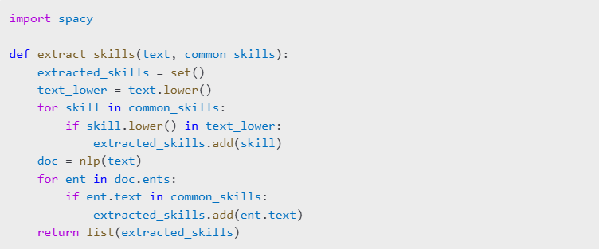
Extracting Skills using NLP
We need to detect skills from resume text.
Matching predefined skills (manual list).
Using spaCy Named Entity Recognition (NER) for skill extraction.

Slide 9
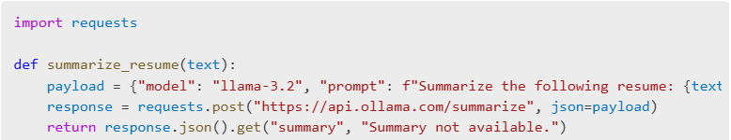
Summarizing Resume using LLaMA
To provide a quick summary of the candidate’s profile.
Used LLaMA 3.2 via the Ollama API to generate a concise summary.

Slide 10
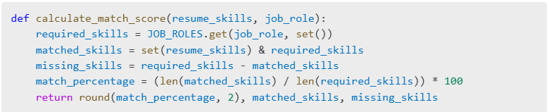
Calculating Match Score
Why?
To compare the resume’s skills with job role requirements.
How?
Find common skills.
Calculate the percentage of matching skills.
Identify missing skills.

Slide 11
Learning Recommendations
To help users fill skill gaps.
How? If a skill is missing, provide relevant courses. Example Output: Missing Skill: AWS Recommended Course: AWS Certified Solutions Architect - Udemy
Interface using Gradio: To provide an easy-to-use platform for users. User uploads resume. Selects a job role. Clicks a button to see results

Slide 12
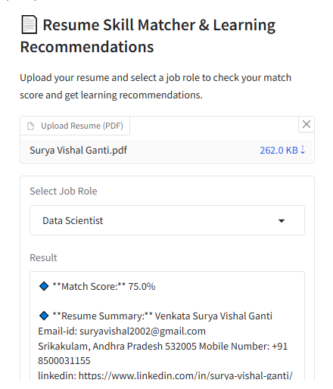
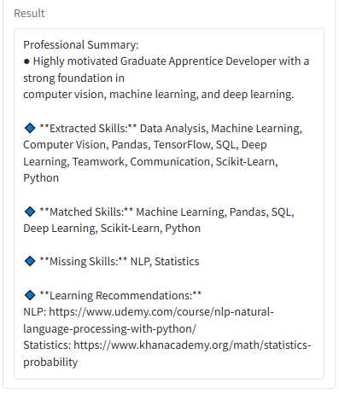
Results

Slide 13
THANK YOU

